Slide 1
API Life Cycle and CI/CD Process
Krishna Subburayalu, SA

Slide 2
Agenda
Anypoint Platform Tools Mapping to API Life Cycle
API Life Cycle in depth
CI/CD Process
Migrate API definitions and policies

Slide 3
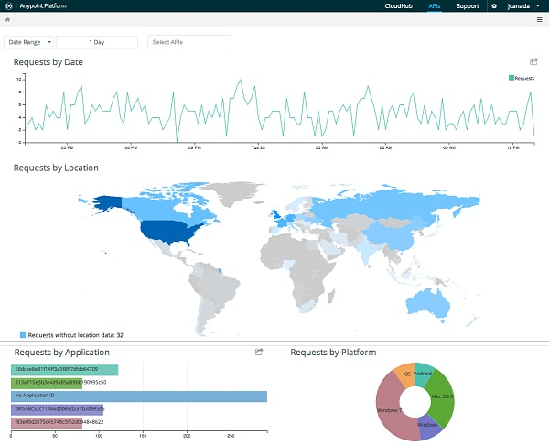
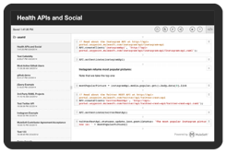
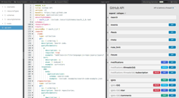

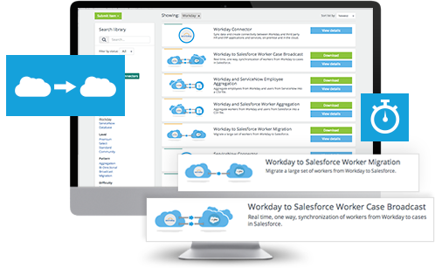
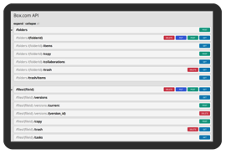
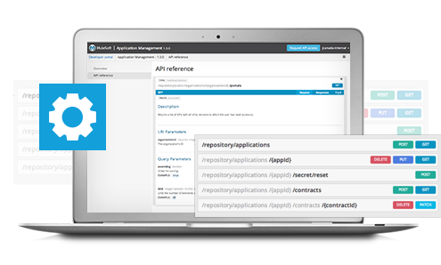

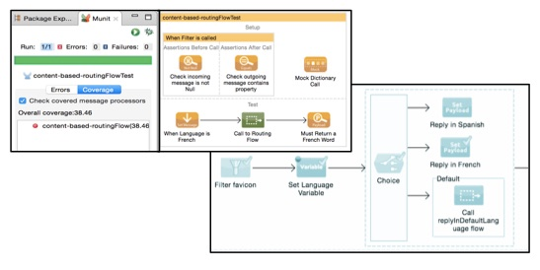
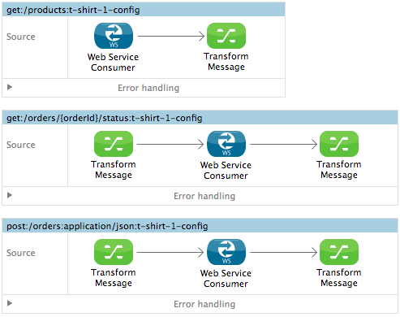
MuleSoft Tools mapped to the service life-cycle
Analytics
API Notebook
API Designer
Manage
Anypoint Exchange
Validate
Model
Anypoint Exchange
Engage
Design
API Console
Solicit Feedback
Simulate
API Portal
Mocking Services
Test
Build
Anypoint Studio
MUnit
Anypoint Exchange
Notes:
When it comes to developing services, MuleSoft takes a holistic view. The ideal service development goes beyond the traditional build, test, deploy:
Now lets see how all of this is done with the unified platform that Mule Anypoint provides.
MODEL:
You start by modeling your API with RAML. If you have other API specifications like Swagger, they can be upconverted to get the rich features that can be leveraged in the rest of your lifecycle.
Anypoint Exchange – which is the central repository or all resuable assets contains rich RAML examples, RAML snippets, traits, reusable xml/json schemas, etc in your organization, that you could leverage to accelerate your API spec development and make sure it conforms to best practices.
SIMULATE:
Once you have the RAML spec, you can use the Mocking Services feature in the API Designer to have a live endpoint that will reply with sample data, which it gets from your RAML
Using the work-in-progress portal for your new API, you can now solicit feedback for your mocked API spec from your API consumers who can play around with the API console and try different requests and inspect responses. They do this using the graphical API Console that was auto-generated from the RAML spec
They can also validate the API by writing real code, right within the API portal, using the API Notebook feature that is unique to MuleSoft. These are different code examples that can create and run against the live API endpoint from right within the browser. Based on the feedback from trying out the API, the API designer can make necessary changes and iterate on the API spec
BUILD:
-When you have a final iteration of the RAML spec, you are ready to implement the actual service!
-You do this by importing the RAML into Anypoint Studio. Which recognizes the different resources and methods that need to be implemented and auto-generates the corresponding scaffolding for you to start your implementation
-Using the palette in studio, you can drag and drop different components, transformers, connectors, filters, integration patterns, etc and build out your business logic
-Studio also allows you to bring your favorite language using the polyglot Mule transformer that includes support for Javascript, Python, .NET, Groovy, etc.
-Again, Anypoint Exchange can be leveraged here to see if there are any downloadable connectors, best practise Mule examples or template projects that you can leverage for your service implementation
TEST
- Using the Test Driven Design approach, you can start defining your unit tests and functional tests. You do this using the Mule Unit (Munit) testing framework that allows a drag and drop method to define test cases – it also offers mocking services to mock your back-end systems like DB. So it can send success and failure responses as needed to run assertions against in your test case. Mule also supports JUNit with testing libraries that can be used to define your unit tests, acceptance tests, integration tests.
ENGAGE:
-Once the service is deployed, you can turn off the mocking service in the API Portal and publish it.
-The API Portal will be the landing page for your service and should provide a self-service, self-documenting method for consumers to learn and request access to your API
-The API will also be added to the enterprise catalog of services in Anypoint Exchange, so that it is discoverable based on taxonomy, category, tags and free form searches. Reuse of an existing asset is only as good as it being easily discoverable
MANAGE:
Your service that is live and operation can be managed from the Anypoint Management Center. Where you can protect your service endpoint and control access using various OOTB API policies. You can also get rich analytics on usage for your service, data about consumers of your services, SLA’s, etc
We saw how Exchange came into the picture during multiple points in the service lifecycle.
It helped us discover and leverage existing assets that can include best practise templates, RAML snippets, API’s (for instance, system API’s from the same team/domain)
Ability to provide user ratings, user forums and other collaboration tools encourage “Merit based reuse” in the context of services

Slide 4
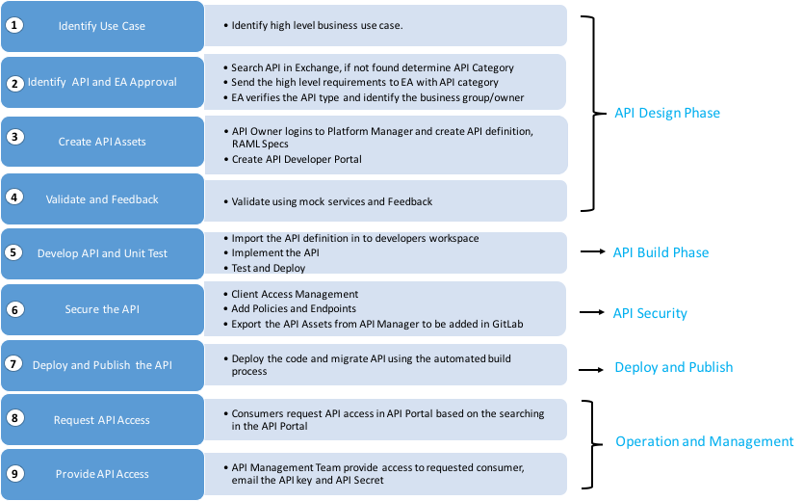
API Life Cycle
On-Premise/Intranet

Slide 5
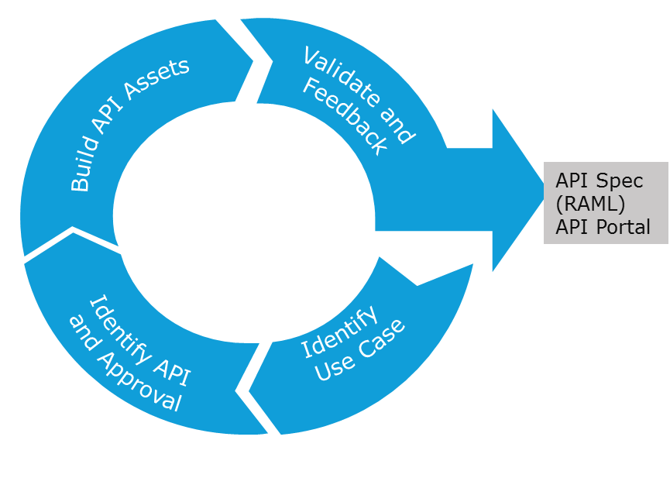
API Life Cycle – Cont’d
API Design Phase
Process Steps | Tools Used | Roles
Identify and understand the business use case. | Sharepoint, MicroSoft Word and any other tools that are used for requirements management | Business Analysts, API Owners, API Developers, API Architects
Identify APIs, Resources and EA Approval | Anypoint Exchange and Anypoint API Designer, Outlook | API Owners and API Developers, API Architects
Create API Assets | Anypoint Manager: API Designer and API Portal | API Owners and API Developers
Validate and Feedback | API Portal, Post Man or SOAP UI | API Architects, Business Analysts, QA
On-Premise/Intranet

Slide 6
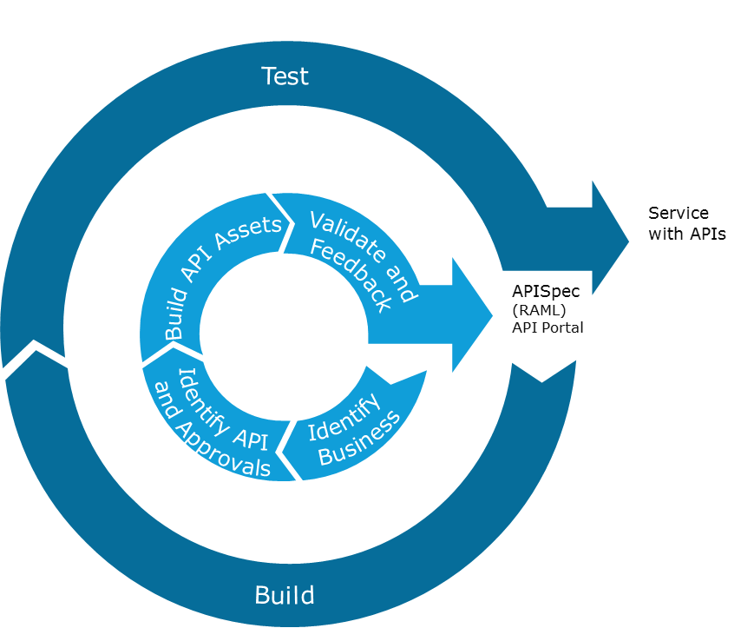
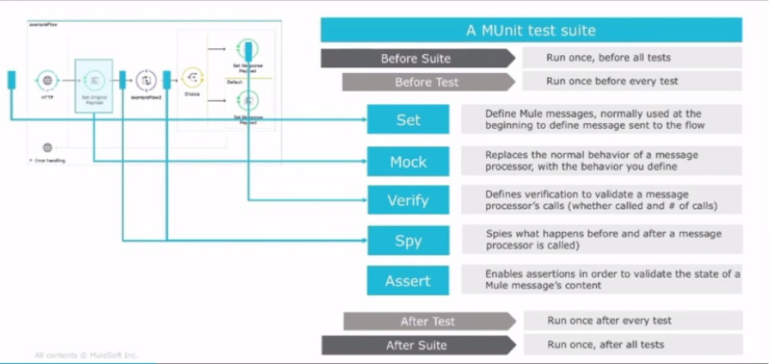
API Life Cycle – Cont’d
API Build Phase
Process Steps | Tools Used | Roles
Develop API using the API Specs | Anypoint Studio, Post Man or SOAP UI, Anypoint Exchange | API Developers
Test the Service | Anypoint Studio, MUnit, Post Man or SOAP UI | API Developers
On-Premise/Intranet

Slide 7
API Life Cycle – Cont’d
API Security
Process Steps | Tools Used | Roles
Identity Management | Anypoint Access Management | API Admins/Release Management
Policy and Endpoint Configuration | Anypoint API Manager | API Developers
API Assets Export | Anypoint API Manager | API Developers
Deploy and Publish
Process Steps | Tools Used | Roles
Source Code and API assets Check-in | Anypoint Studio and Source Code Control System like TFS, Git, SVN etc. | API Developers
Configure Build Job | Build Servers like Jenkins, Bamboo, Circle CI, Octopus etc | Dev Ops/Release Management
Deploy and Migrate APIs | Build Servers, API Manager, Mule Runtime | Dev Ops/Release Management
Publication of API in Exchange | API Manager and Exchange | API Owners
On-Premise/Intranet

Slide 8
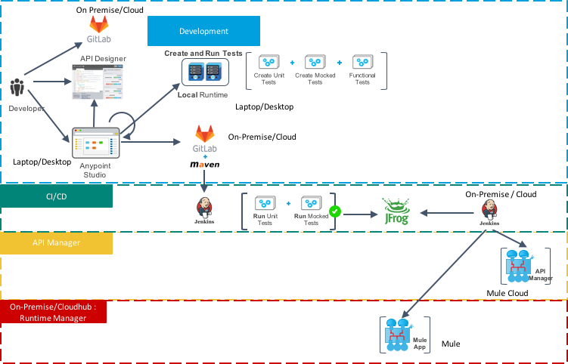
MuleSoft Anypoint Platform – CI/CD Process
On-Premise/Intranet

